Slide 1
Supervisor: Prof. Siamak Tavakoli Course: Software Architecture Maharshi International University Fairfield, Iowa, 52556
Presentation on
WebStore
Presentation by ,
Anil Maharjan
Siddhant Pageni
Eria O. Pinyi

Slide 2
Project Summary
Design Class diagram, Domain Diagram, Component Diagram and
Create the customer service, product service, cart service, cart query service, and order service
Configure the zipkin, Kafka, zookeeper and kafka magics
Create the config server
Create the registry server and failover registry server for fallback
Create the API gateway with building in Circuit Breaker
Create the load balancing service for product services
Create CQRS pattern by deploying messaging channel for publish and subscribe between Cart Service and Cart Service Query.
Create REST-template

Slide 3
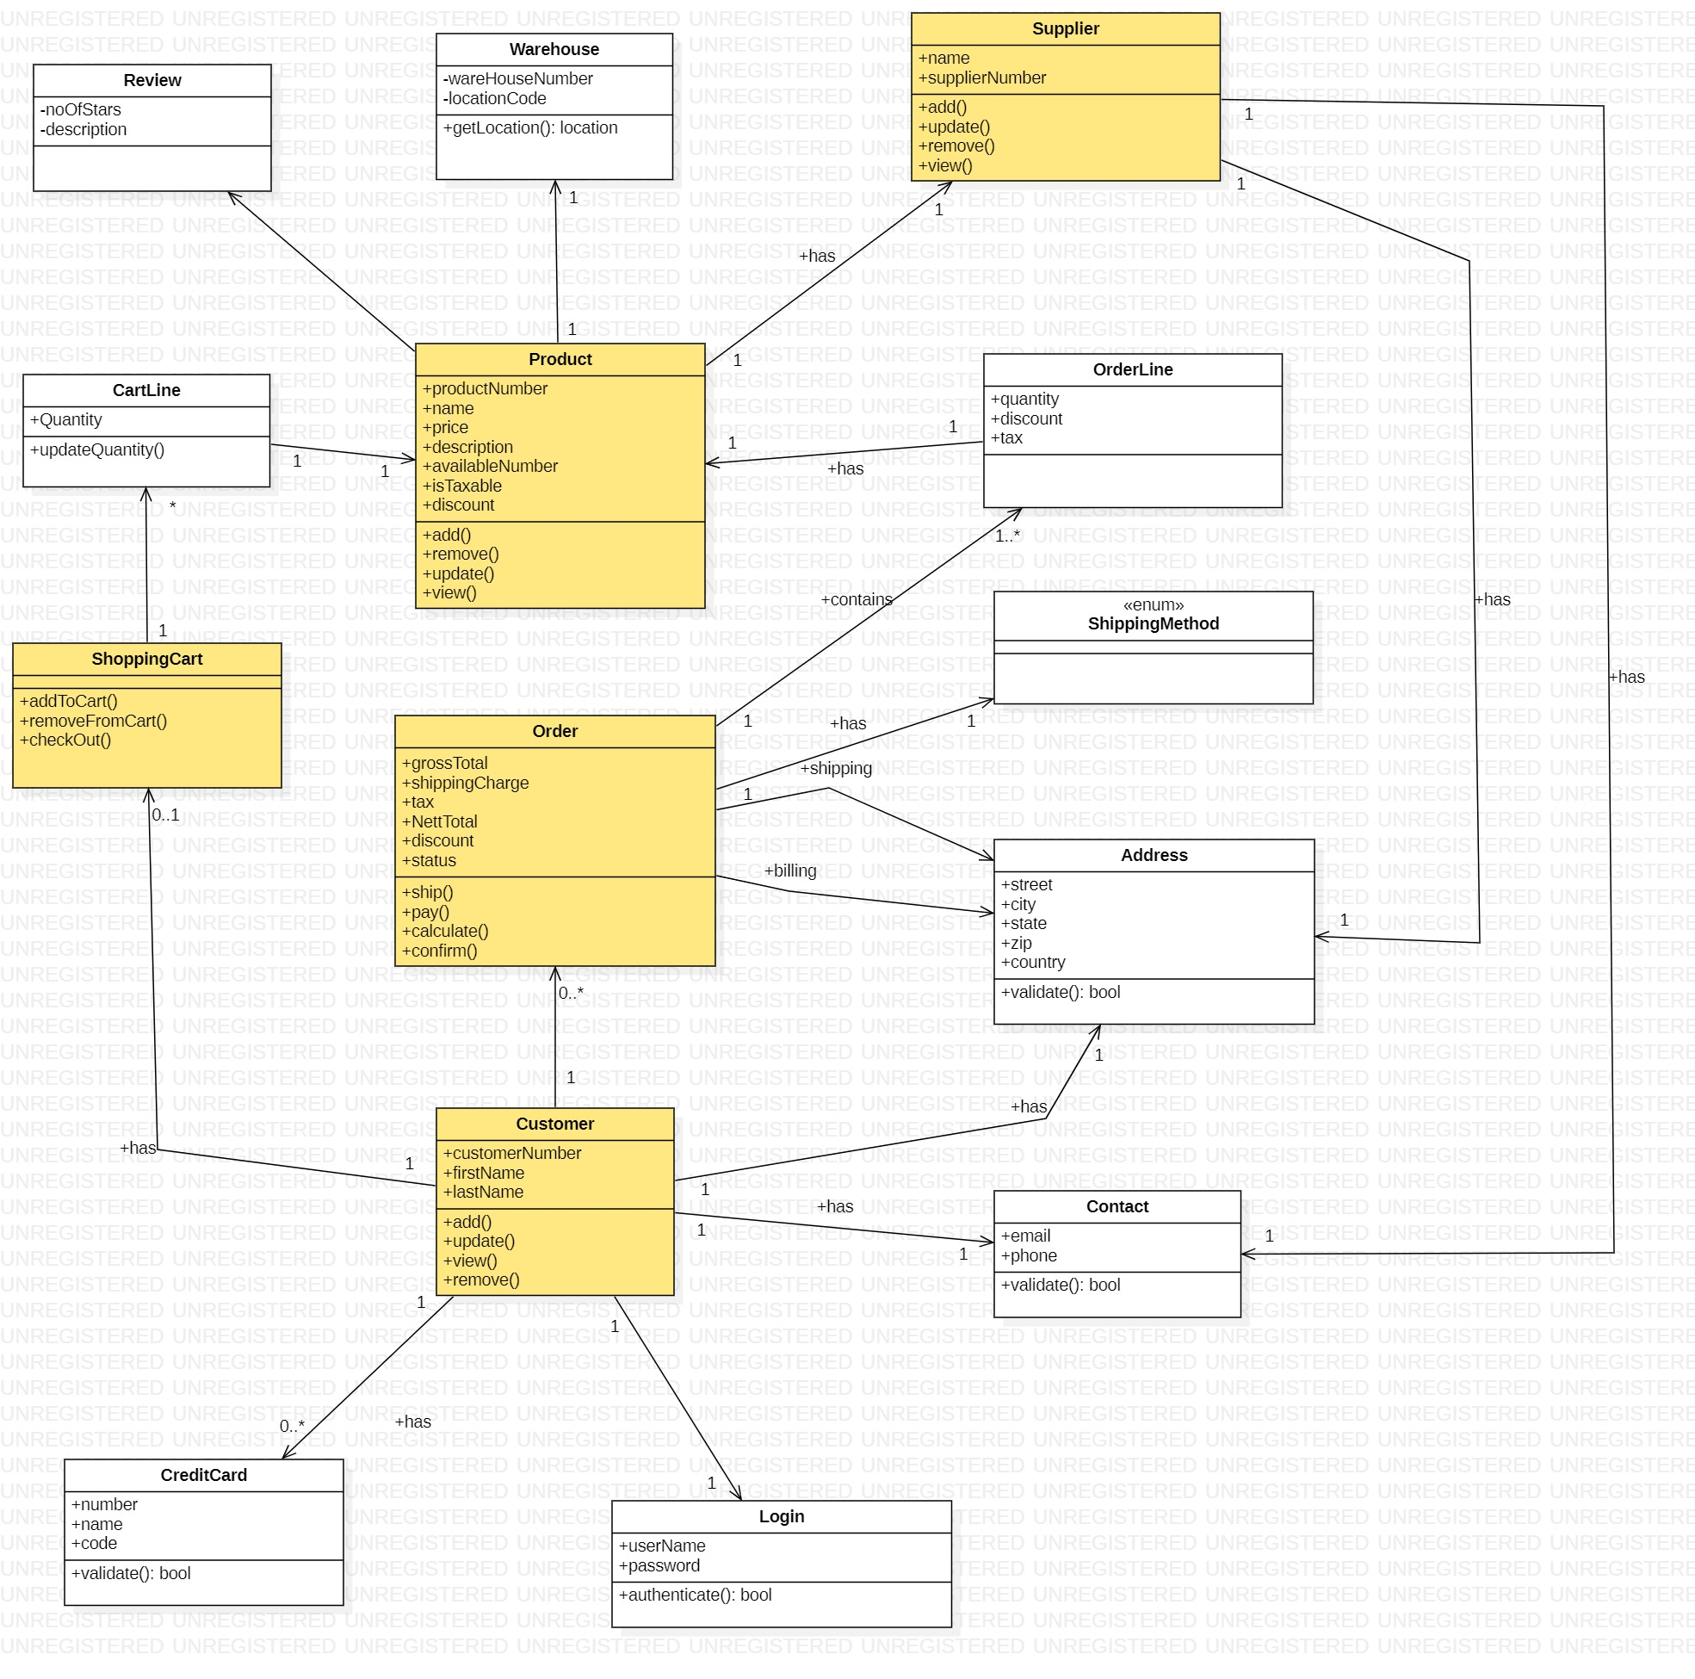
Class Diagram

Slide 4
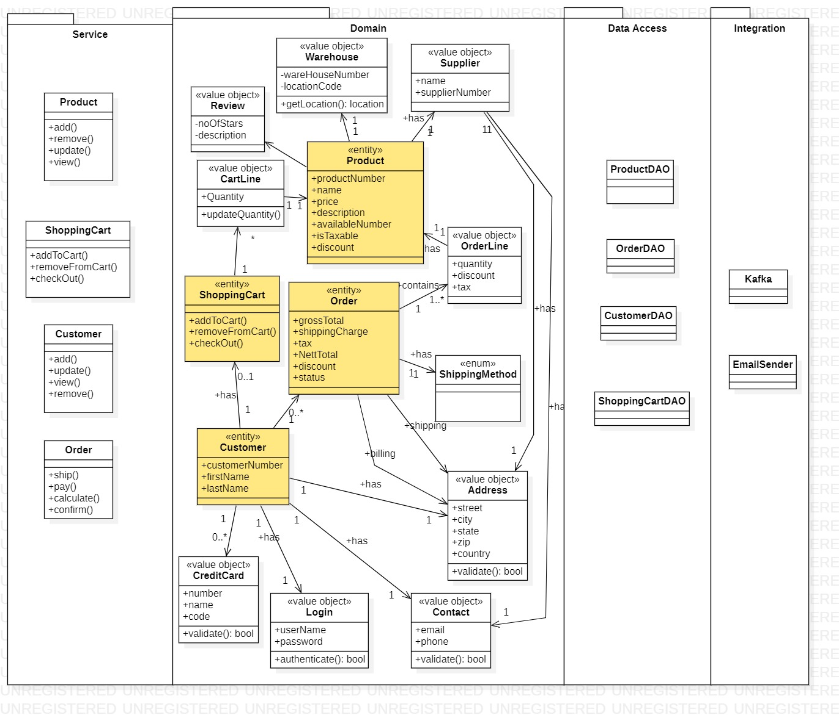
Domain Diagram
Entities
Customer
Product
Shopping Cart
Order
Value Object
Review
Warehouse
Supplier
Orderline
Address
Contact
ShippingMethod

Slide 5
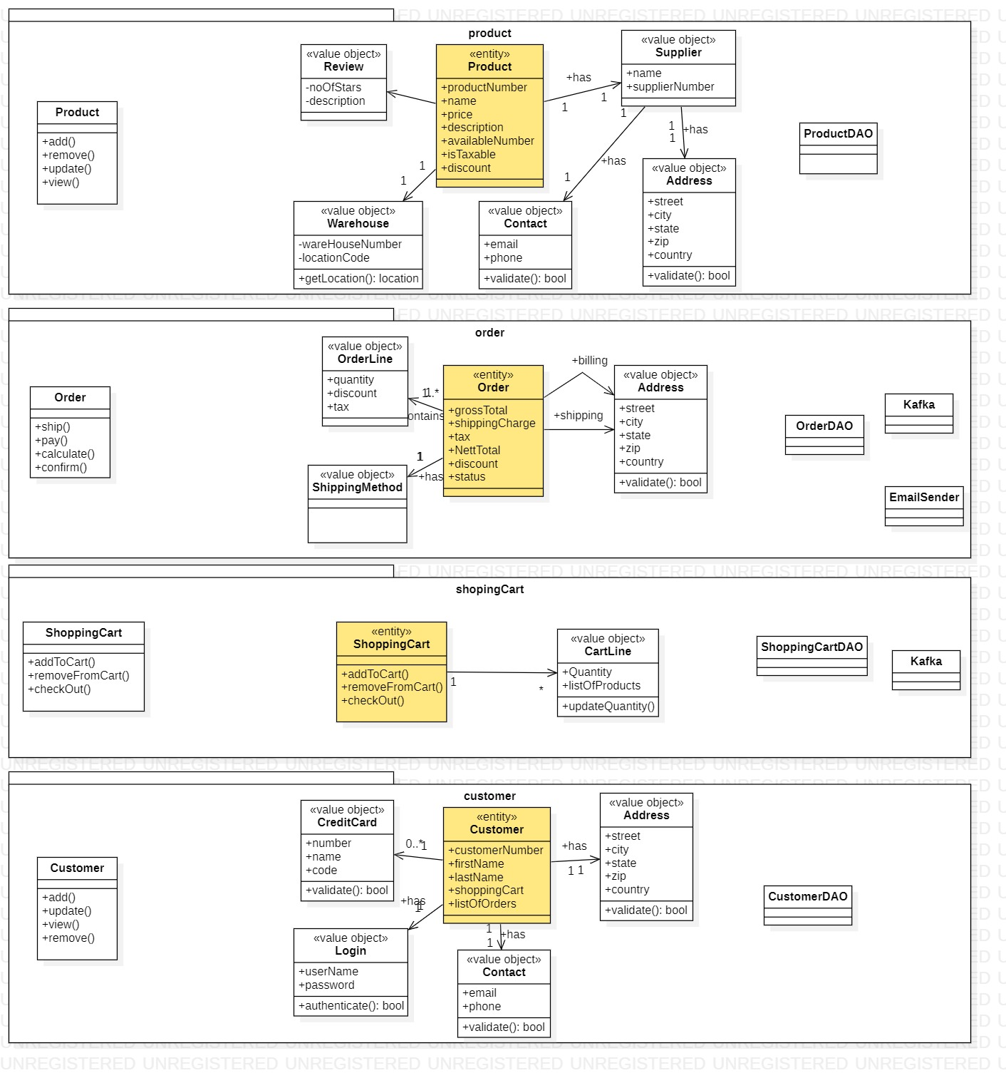
Component Diagram
Product Component
Order Component
Shopping Cart Component
Customer Component

Slide 6
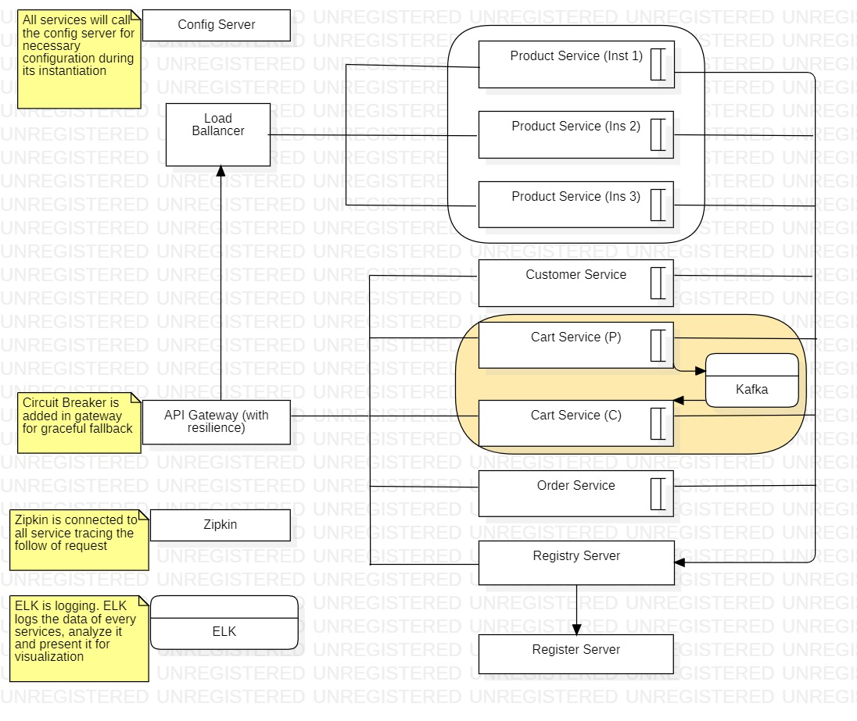
Service Architecture Design

Slide 7
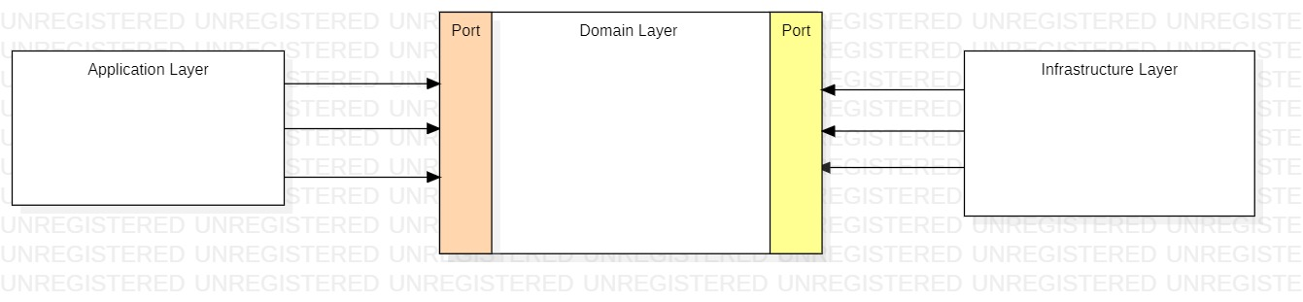
Hexagon DDD Pattern
Application Layer
Through this layer the client interacts with the application
Domain Layer
Here we implement the business logic
It is isolated from Application layer and infrastructure layer
It contains API to communicate with Application and Infrastructure layer
Infrastructure Layer
It contains all that application needs for working like
Database
Messaging
DTO

Slide 8
Hexagon DDD Pattern
Application Layer
Through this layer the client interacts with the application
Domain Layer
Here we implement the business logic
It is isolated from Application layer and infrastructure layer
It contains API to communicate with Application and Infrastructure layer
Infrastructure Layer
It contains all that application needs for working like
Database
Messaging
DTO

Slide 9
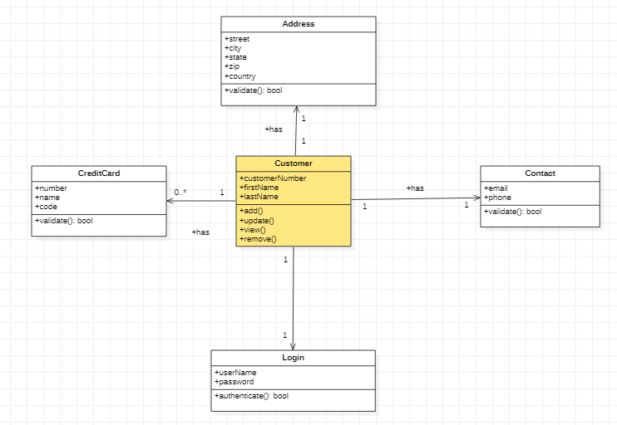
Customer Service
Embodied functionalities
Add
Remove
View
List
Update
Domain object
Customer
Value Objects
Address
Contact
CreditCard
Login

Slide 10
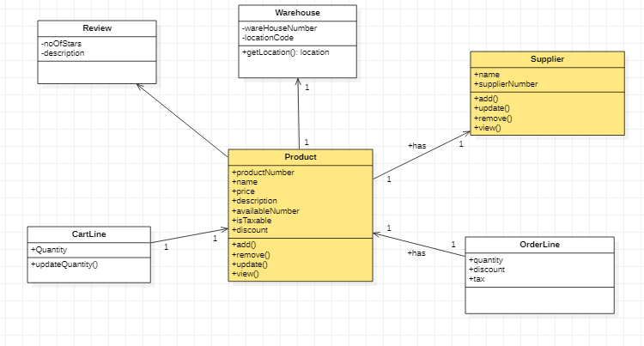
Product Service
Embodied functionalities
Add
Remove
View
List
Update
Domain object
Product
Supplier
Value Objects
Address
Contact
Warehouse
Review
Cartline

Slide 11
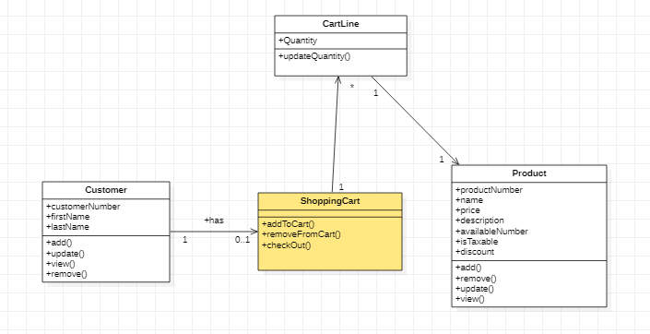
Shopping Service
Embodied functionalities
Add product
Remove
View
List
Update product
Checkout
Domain object
ShoppingCart
Customer
Product
Value Objects
Cartline

Slide 12
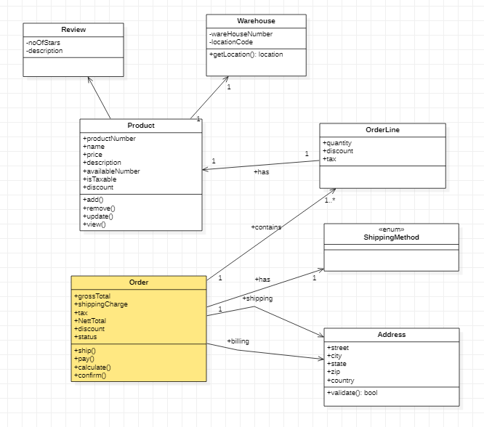
Order Service
Embodied functionalities
Change Quantity
Calculate
Place Order
Domain object
Product
Order
Value Objects
Review
Warehouse
Orderline
Address

Slide 13
Patterns Used
Config Server
Eureka Registry Service and its failover management
API Gateway
Resilience
Load Balancer
Distributed Tracing
CQRS and Event Sourcing
Kafka Messaging Pattern

Slide 14
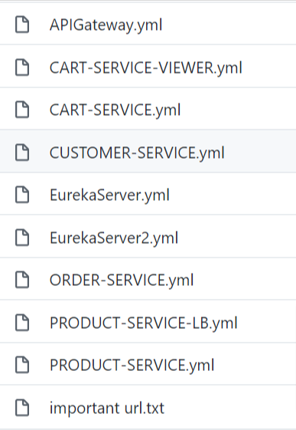
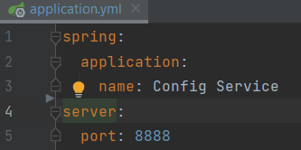
Config Server
External configuration service
Removes configuration from code
Used git for maintaining configuration files

Slide 15
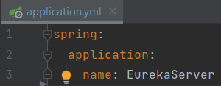
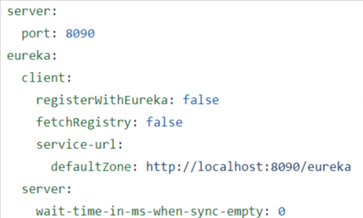
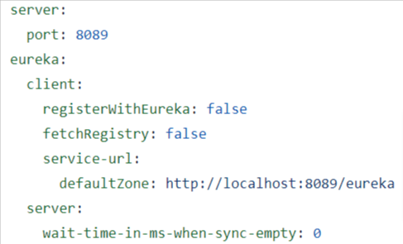
Registry Service
Eureka Failover
Like a phone director
Holds information of the client and its location
Clients registers themselves and read from register server
Registry server does regular health check
Ensures high availability

Slide 16
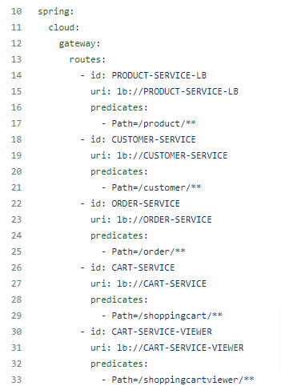
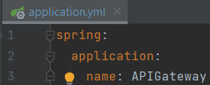
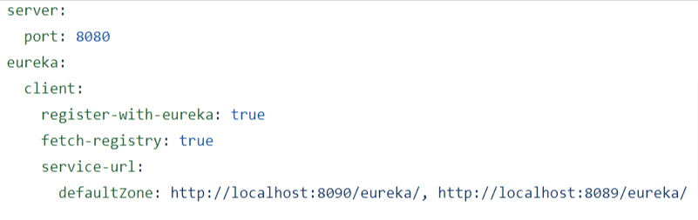
API Gateway
Offers proxy to redirect or route request to endpoint
Act as a single endpoint for client applications
Can have pre-, post-, error-, and route- filter

Slide 17
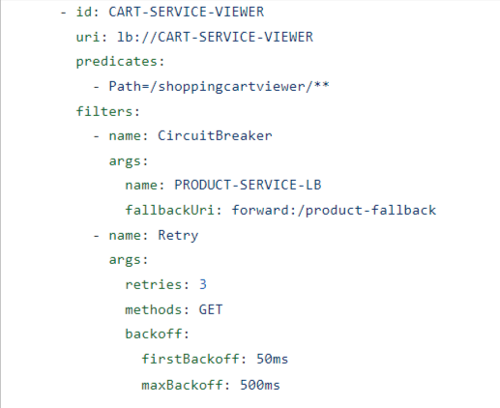
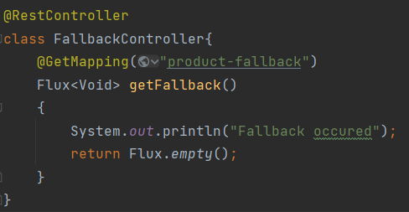
API Gateway - Resilience
Eureka server cannot handle the chatty communication
Resilience help to tackle this via circuit breaker
Configuration for circuit breaker is shown here

Slide 18
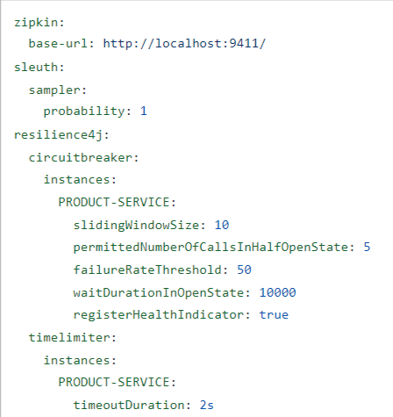
Zipkin and Sleuth
Use for tracing the request
Uses span id and trace id
Configuration to placed in services in show here

Slide 19
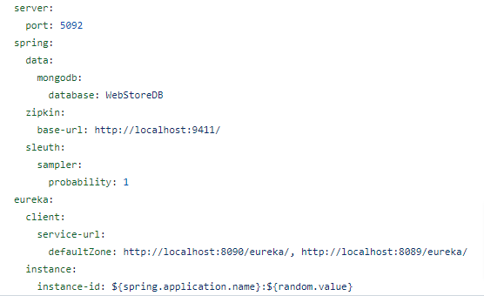

Load Balancer
Help to controller the traffic to a service
By default Round Robin is used
If one service gets down then other one will be used
Ensures high availability

Slide 20
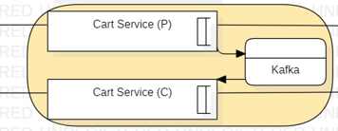
CQRS and Event Sourcing
Separated the command and Query
Cart Server acts as a command service and produces the message to Kafka
Cart Viewer acts as a query service and consumer the message from Kafka

Slide 21
Challenges
Kafka
We had faces challenges in syncing the object between Producer and Consumer
For solution, we had used the string message, which is the json format of the object
ELK:
We tried to configured the ELK in project
However,
We had faced the problem in configuring the logstash

Slide 22
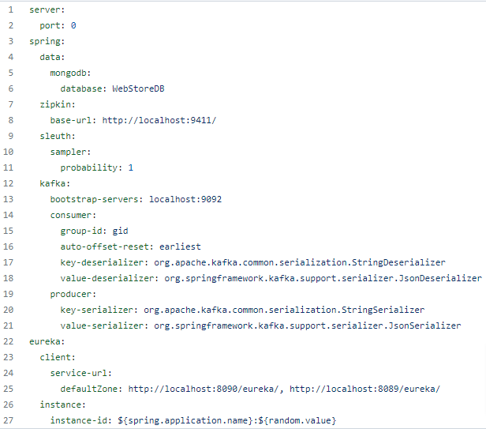

Cart Service (Command)
Service to handle
Add product
Remove product
Change quantity
Checkout cart
On checkout it produces the event

Slide 23
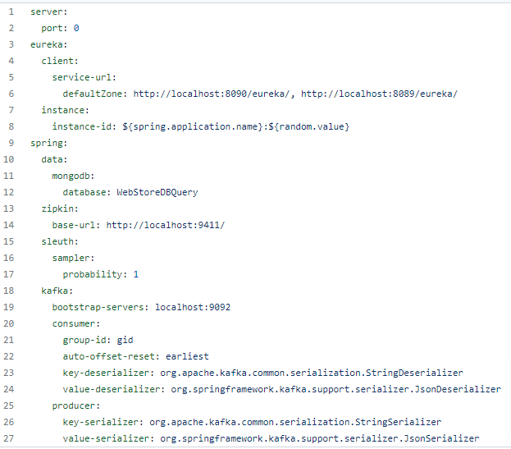
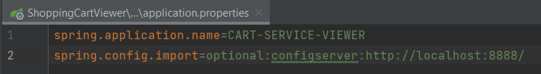
Cart Service (Query)
Service to handle
Listen to event produced by Command Cart Service
Saves and update changes in cart to separate database
Handles queries related to view carts

Slide 24
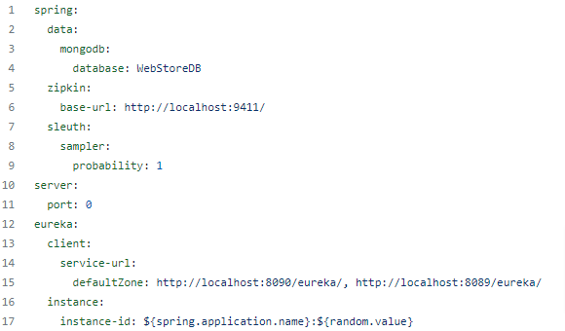
Product Service
Service to handle
Add product
Remove product
View product

Slide 25
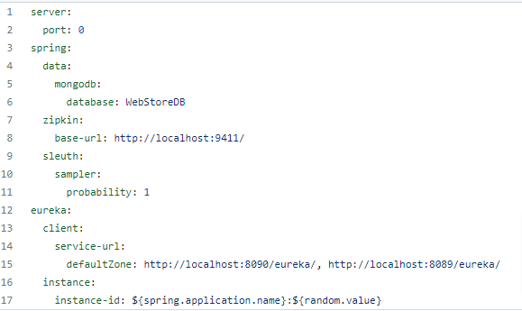

Customer Service
Service to handle
Add Customer
Remove Customer
View Customer

Slide 26
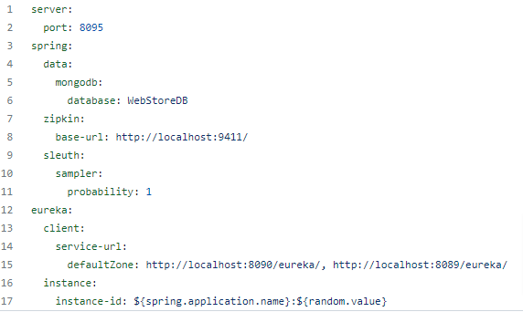

Order Service
Service to handle
Create order
View order

Slide 27
Order Service
Service to handle
Create order
View order

Slide 28
Extension Plan
Integration of Authentication Server
Integration of product category
Integration of the payment system
Integration of the email services
Integration of front end view via react, and so on

Slide 29
THANK YOU

